Slide 1


WHY GO SOLAR?
Increasing costs:
Electricity prices increasing and getting more expensive.
High electricity bills being a headache.
High demand of electricity to meet therefore renewable energy is the better alternative.
Renewable energy at lower cost and save money long term.
Unreliability:
Eskom is unreliable with all the power failures and load shedding.
Load shedding is part of your daily routine.
Increase in electricity cables being stolen.
Environmentally Friendly:
Solar is a clean source of power and reduce the carbon footprint.
Generates energy from the sun which is for free.
We need energy storage/ back up to keep the lights on when Eskom can’t.

Slide 2





HOW THE PROCESS WORKS
Consultation meeting
Proposal
Lightup Enterprise and the Client
Maintenance
Design and engineering
Installation

Slide 3

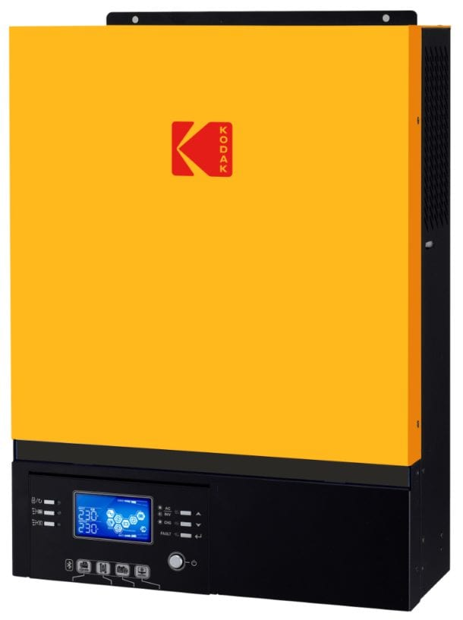
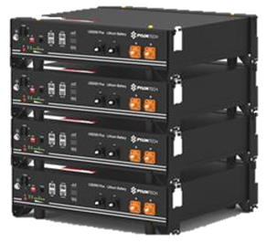
OUR PRODUCTS
Solar panels
Solar Batteries
Off-grid inverter
Hybrid inverter

